Slide 1
Troubleshooting Kubernetes Kubernetes Master Class Series
#Rancherk8s
February 4, 2020

Slide 2
Rancher Master Class Series:
45 minutes - 1 Hour
Questions are always welcome
Use the questions tab to write your questions
We may respond to all, so mark your question as private if needed.
#Rancherk8s

Slide 3
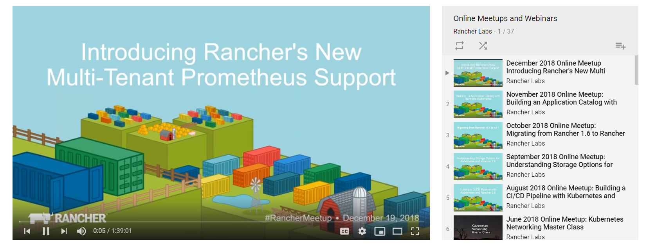
This session is being recorded!
http://youtube.com/c/rancher
#Rancherk8s

Slide 4
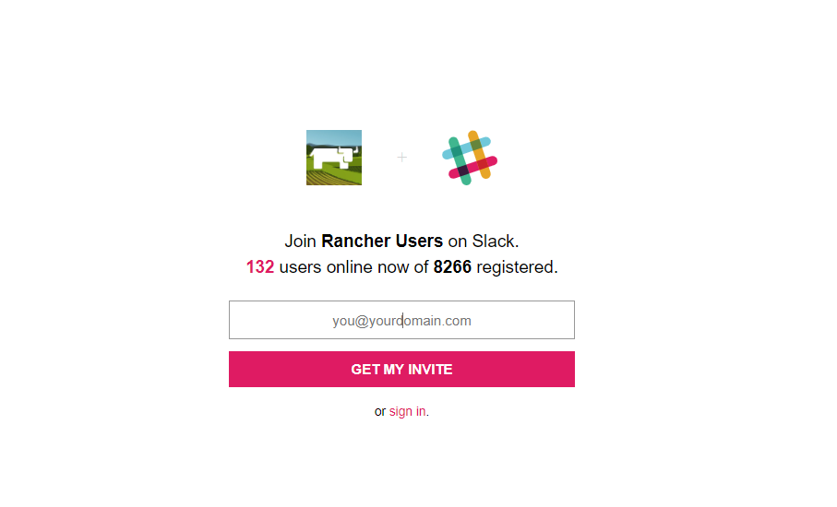
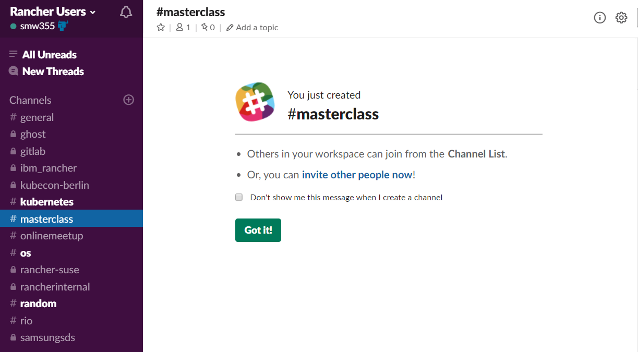
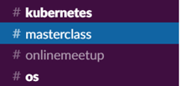
Join the conversation on Slack
http://slack.rancher.io
#masterclass
#RancherK8s

Slide 5
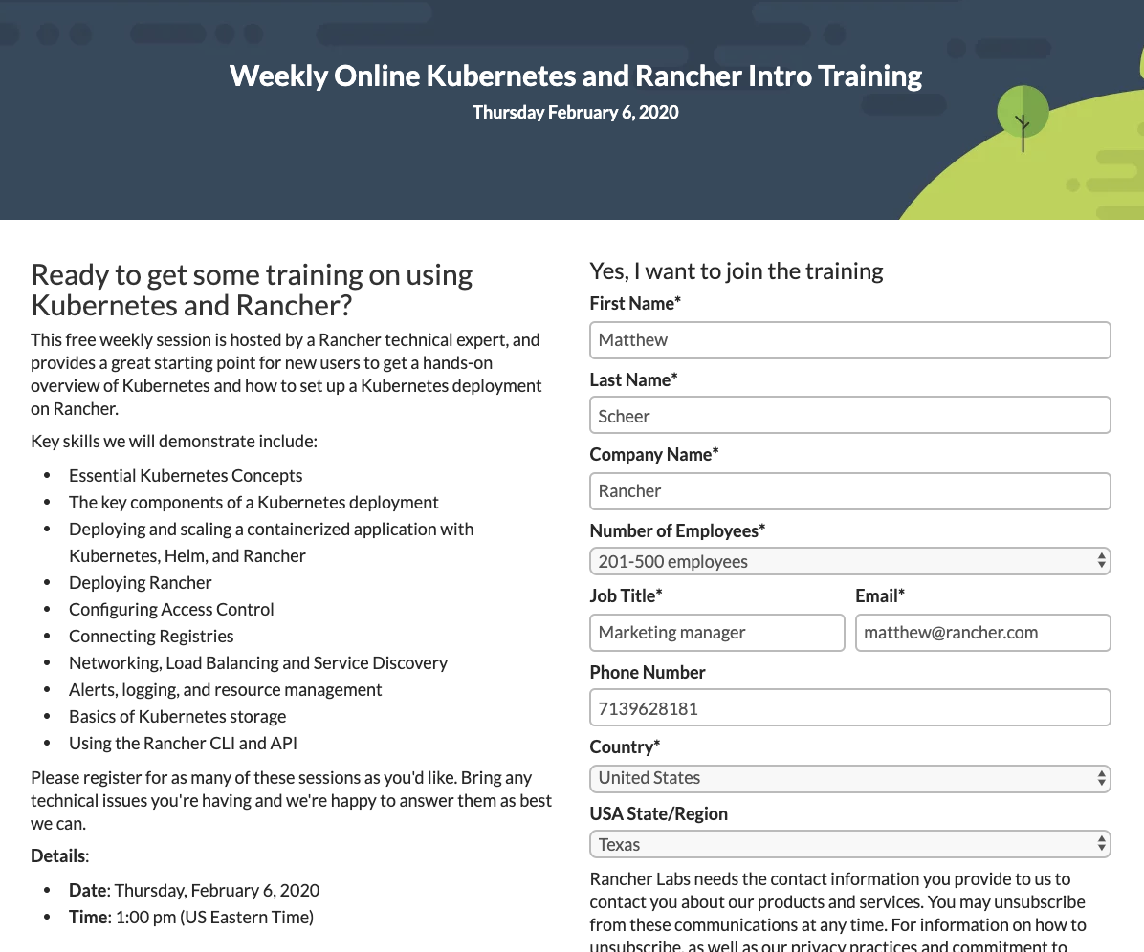
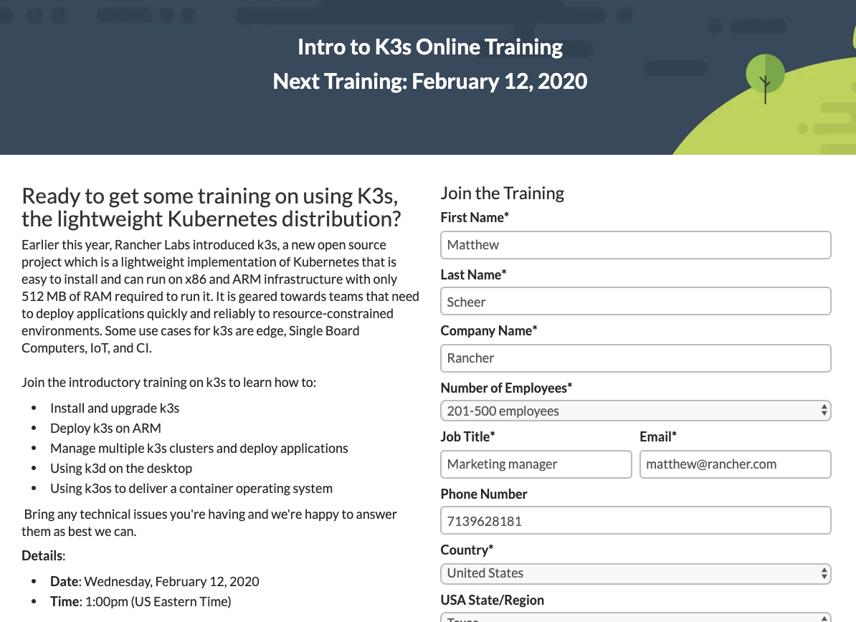
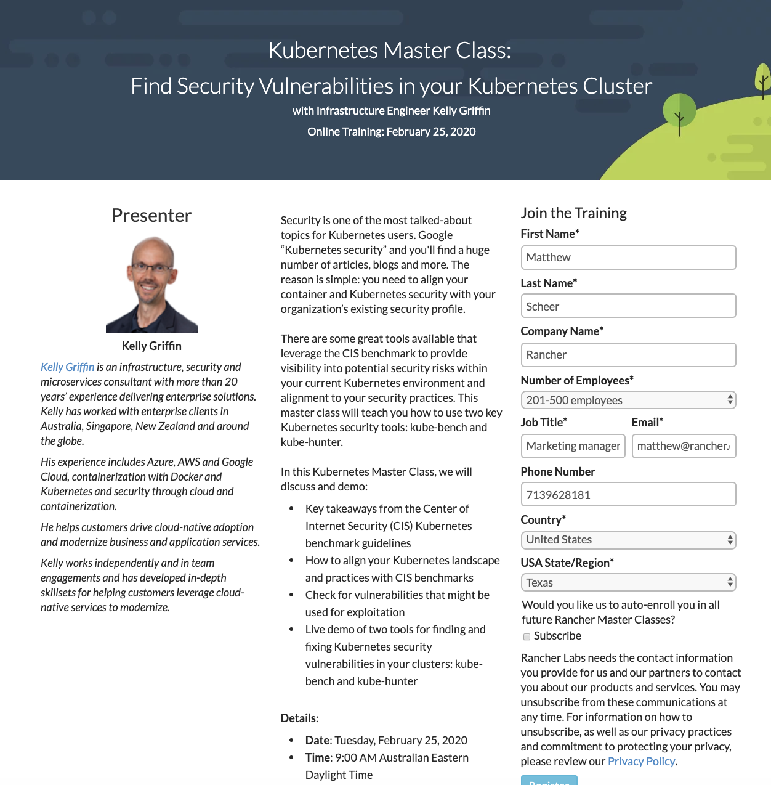

Slide 6
Who am I
Matthew Mattox
Support Engineer
https://github.com/mattmattox
#RancherK8s

Slide 7
Agenda
Kubernetes basics
Troubleshooting techniques
Kubernetes components
Kubernetes resources
Recommendations
Note: all examples are based on Kubernetes cluster built using RKE v1.0.4 but can be used on any Kubernetes distribution with minor adjustments.
#RancherK8s

Slide 8
Kubernetes basics
etcd
Stores the state of the cluster
control plane (master)
kube-apiserver
front end to your cluster, interacts with state in etcd
kube-controller-manager
controllers that ensure cluster is according to desired state
kube-scheduler
schedules your workloads according to requirements
worker
kubelet
cluster node agent
kube-proxy
provides networking logic for workloads
#RancherK8s

Slide 9
#RancherK8s

Slide 10
etcd
Distributed key value store
All data of Kubernetes is stored in etcd
Majority of nodes / quorum
etcd cluster of 2 is worse than 1
3 node clusters are standard/recommend
Sensitive to disk write latency
Space quota
History of keyspace
Compaction & defrag
Helpful Doc
https://rancher.com/docs/rancher/v2.x/en/troubleshooting/kubernetes-components/etcd/
#RancherK8s

Slide 11
kube-apiserver
The entry point for your cluster
Uses etcd to maintain state
Active-active round-robin possible
Helpful Doc
https://rancher.com/docs/rancher/v2.x/en/troubleshooting/kubernetes-components/controlplane/
#RancherK8s

Slide 12
kube-controller-manager
Controller loops for getting cluster in desired state
Commonly known controllers
Node
Replication
Endpoints
Service Account
Talks to kube-apiserver
One active per cluster, using leader election
Helpful Doc
https://rancher.com/docs/rancher/v2.x/en/troubleshooting/kubernetes-components/controlplane/
#RancherK8s

Slide 13
kube-scheduler
Schedules pods according to requirements (resource/label/taints etc)
Talks to kube-apiserver
One active per cluster, using leader election
Helpful Doc
https://rancher.com/docs/rancher/v2.x/en/troubleshooting/kubernetes-components/controlplane/
#RancherK8s

Slide 14
Troubleshooting techniques
Assess
What error/logging is shown
docker logs & kubectl logs
Search existing issues
Relate timestamps from logging to events from timeline (All timestamps should be in UTC)
What triggered this situation/what changed
Infrastructure / Firewall changes
OS Patching / Upgrades
Large deployments
Does it affect everything or a certain part (hardware/datacenter/region/availability zone)
How does this differ from your baseline/tests
#RancherK8s

Slide 15
Troubleshooting techniques
Fix
Compare working and non-working components/resources
Isolate the issue
Test components directly (curl the readiness & liveness probes)
(Temporarily) remove affected node from pool
Stop the component to make sure you are talking to the right component (IP change or duplicate IP)
Apply workaround/fix found in existing issue
Reproduce in test environment
#RancherK8s

Slide 16
Troubleshooting etcd
Follow up
Second most important step
What was the root cause
What situation was caught or not caught
What could be recovered/replaced automatically
What took the most time
#RancherK8s

Slide 17
Troubleshooting etcd
Check etcd members (this is not a live view)
root@a1ubrkeat01:~# docker exec etcd etcdctl member list
2f080bc6ec98f39b, started, etcd-a1ubrkeat03, https://172.27.5.33:2380,
9d7204f89b221ba3, started, etcd-a1ubrkeat01, https://172.27.5.31:2380,
bd37bc0dc2e990b6, started, etcd-a1ubrkeat02, https://172.27.5.32:2380,
#RancherK8s

Slide 18
Troubleshooting etcd
Check endpoint health (this is a live view)
root@a1ubrkeat01:~# curl https://raw.githubusercontent.com/mattmattox/etcd-troubleshooting/master/etcd-endpoints | bash
Validating connection to https://172.27.5.33:2379/health
{"health":"true"}
Validating connection to https://172.27.5.31:2379/health
{"health":"true"}
Validating connection to https://172.27.5.32:2379/health
{"health":"true"}
#RancherK8s

Slide 19
Troubleshooting etcd
Check etcd logging (docker logs etcd)
health check for peer xxx could not connect: dial tcp IP:2380: getsockopt: connection refused
A connection to the address shown on port 2380 cannot be established. Check if the etcd container is running on the host with the address shown.
xxx is starting a new election at term x
The etcd cluster has lost it’s quorum and is trying to establish a new leader. This can happen when the majority of the nodes running etcd go down/unreachable.
connection error: desc = "transport: Error while dialing dial tcp 0.0.0.0:2379: i/o timeout"; Reconnecting to {0.0.0.0:2379 0 <nil>}
The host firewall is preventing network communication.
rafthttp: request cluster ID mismatch
The node with the etcd instance logging rafthttp: request cluster ID mismatch is trying to join a cluster that has already been formed with another peer. The node should be removed from the cluster, and re-added.
rafthttp: failed to find member
The cluster state (/var/lib/etcd) contains wrong information to join the cluster. The node should be removed from the cluster, the state directory should be cleaned and the node should be re-added.
Helpful Doc: https://github.com/mattmattox/k8s-troubleshooting#common-errors
#RancherK8s

Slide 20
Troubleshooting etcd
Configure loglevel to be DEBUG
curl -XPUT -d '{"Level":"DEBUG"}' --cacert $(docker exec etcd printenv ETCDCTL_CACERT) --cert $(docker exec etcd printenv ETCDCTL_CERT) --key $(docker exec etcd printenv ETCDCTL_KEY) https://localhost:2379/config/local/log
Restore loglevel to be INFO
curl -XPUT -d '{"Level":"INFO"}' --cacert $(docker exec etcd printenv ETCDCTL_CACERT) --cert $(docker exec etcd printenv ETCDCTL_CERT) --key $(docker exec etcd printenv ETCDCTL_KEY) https://localhost:2379/config/local/log
NOTE: Do not leave debug logging on in Production
#RancherK8s

Slide 21
Troubleshooting etcd
Getting etcd metrics
curl -X GET --cacert $(docker exec etcd printenv ETCDCTL_CACERT) --cert $(docker exec etcd printenv ETCDCTL_CERT) --key $(docker exec etcd printenv ETCDCTL_KEY) https://localhost:2379/metrics
wal_fsync_duration_seconds (99% under 10 ms)
A wal_fsync is called when etcd persists its log entries to disk before applying them.
backend_commit_duration_seconds (99% under 25 ms)
A backend_commit is called when etcd commits an incremental snapshot of its most recent changes to disk.
Helpful Doc: https://github.com/mattmattox/k8s-troubleshooting/blob/master/README.md#getting-etcd-metrics
#RancherK8s

Slide 22
Troubleshooting kube-apiserver
Check etcd connectivity/responsesiveness
kube-apiserver -> each etcd server
https://raw.githubusercontent.com/mattmattox/k8s-troubleshooting/master/kube-apiserver-check-etcd
Check round_trippers
https://github.com/mattmattox/k8s-troubleshooting/blob/master/kube-apiserver-responsiveness
This should be below 200ms
#RancherK8s

Slide 23
Troubleshooting kube-controller-manager
Find current leader
kubectl -n kube-system get endpoints kube-controller-manager -o jsonpath='{.metadata.annotations.control-plane\.alpha\.kubernetes\.io/leader}’
https://raw.githubusercontent.com/mattmattox/k8s-troubleshooting/master/kube-controller-manager
SSH to node
docker logs -f kube-controller-manager
#RancherK8s

Slide 24
Troubleshooting kube-scheduler
Find current leader
kubectl -n kube-system get endpoints kube-scheduler -o jsonpath='{.metadata.annotations.control-plane\.alpha\.kubernetes\.io/leader}’
https://raw.githubusercontent.com/mattmattox/k8s-troubleshooting/master/kube-scheduler
SSH to node
docker logs -f kube-scheduler
#RancherK8s

Slide 25
Troubleshooting kubelet
Check kubelet logs
docker logs kubelet
Check kubelet stats
curl -sLk --cacert /etc/kubernetes/ssl/kube-ca.pem --cert /etc/kubernetes/ssl/kube-service-account-token.pem --key /etc/kubernetes/ssl/kube-service-account-token-key.pem https://127.0.0.1:1020/stats
For example, nodefs or imagefs stats regarding DiskPressure
Helpful Doc: https://github.com/mattmattox/k8s-troubleshooting#kubelet-troubleshooting
#RancherK8s

Slide 26
Troubleshooting Generic Pods
Get pods
Is state Running and how many Restarts?
Check Liveness/Readiness probes
Logs
Logging usually shows (depends on app) why it can’t start properly (or why it is not able to respond to the Liveness/Readiness probes)
Describe pods
Events shown in human readable format
#RancherK8s

Slide 27
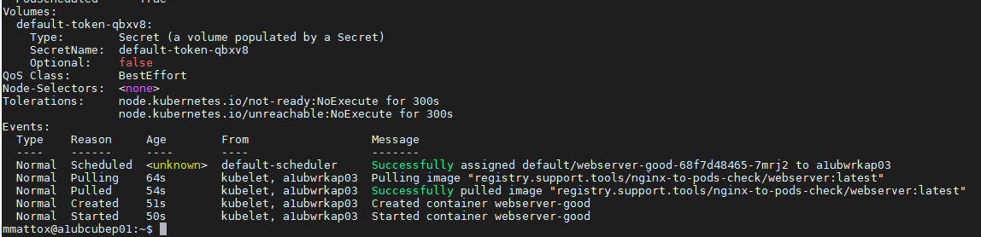
Troubleshooting Generic Pods
kubectl describe pod
#RancherK8s

Slide 28
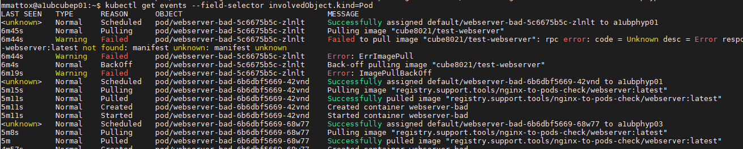
Troubleshooting Generic Pods
kubectl get events --field-selector involvedObject.kind=Pod
#RancherK8s

Slide 29
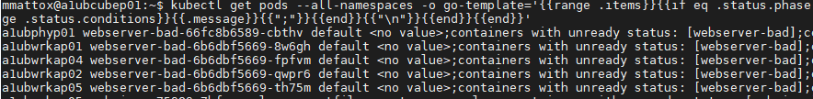
Troubleshooting Generic Pods
kubectl get pods --all-namespaces -o go-template='{{range .items}}{{if eq .status.phase "Pending"}}{{.spec.nodeName}}{{" "}}{{.metadata.name}}{{" "}}{{.metadata.namespace}}{{" "}}{{range .status.conditions}}{{.message}}{{";"}}{{end}}{{"\n"}}{{end}}{{end}}'
#RancherK8s

Slide 30
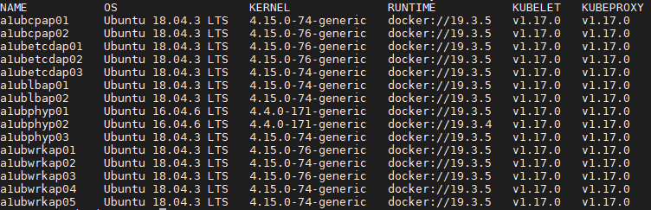
Nodes
Check for differences in nodes
kubectl get nodes -o custom-columns=NAME:.metadata.name,OS:.status.nodeInfo.osImage,KERNEL:.status.nodeInfo.kernelVersion,RUNTIME:.status.nodeInfo.containerRuntimeVersion,KUBELET:.status.nodeInfo.kubeletVersion,KUBEPROXY:.status.nodeInfo.kubeProxyVersion
#RancherK8s

Slide 31
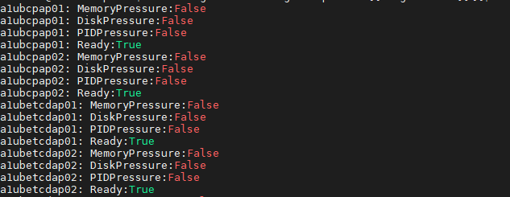
Nodes
Show node conditions
kubectl get nodes -o go-template='{{range .items}}{{$node := .}}{{range .status.conditions}}{{$node.metadata.name}}{{": "}}{{.type}}{{":"}}{{.status}}{{"\n"}}{{end}}{{end}}'
#RancherK8s

Slide 32
Overlay Networking
Ports opened in (host) firewall
https://rancher.com/docs/rancher/v2.x/en/installation/requirements/#port-requirements
Overlay networking is usually UDP
Keep MTU in mind (especially across peering/tunnels)
Simple overlay network check available in Troubleshooting guide
https://rancher.com/docs/rancher/v2.x/en/troubleshooting/networking/#check-if-overlay-network-is-functioning-correctly
#RancherK8s

Slide 33
DNS
Check if internal cluster name resolves
kubectl run -it --rm --restart=Never busybox --image=busybox:1.28 -- nslookup kubernetes.default
Check if external name resolves
kubectl run -it --rm --restart=Never busybox --image=busybox:1.28 -- nslookup www.google.com
Simple DNS check available in Troubleshooting guide:
https://rancher.com/docs/rancher/v2.x/en/troubleshooting/dns/
Monitoring Script: https://github.com/mattmattox/k8s-monitor-dns
#RancherK8s

Slide 34
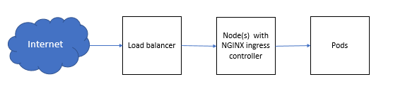
Ingress
Ingress controller (NGINX by default in RKE)
https://github.com/kubernetes/ingress-nginx/blob/master/docs/how-it-works.md
Monitoring Script: https://github.com/mattmattox/NGINX-to-pods-check
#RancherK8s

Slide 35
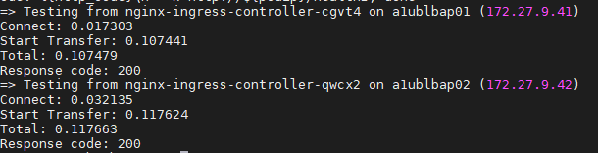
Ingress
Check responsiveness of Ingress Controller
kubectl -n ingress-nginx get pods -l app=ingress-nginx -o custom-columns=POD:.metadata.name,NODE:.spec.nodeName,IP:.status.podIP --no-headers | while read ingresspod nodename podip; do echo "=> Testing from ${ingresspod} on ${nodename} (${podip})"; curl -o /dev/null --connect-timeout 5 -s -w 'Connect: %{time_connect}\nStart Transfer: %{time_starttransfer}\nTotal: %{time_total}\nResponse code: %{http_code}\n' -k http://${podip}/healthz; done
#RancherK8s

Slide 36
Ingress
Check static NGINX config
for pod in $(kubectl -n ingress-nginx get pods -l app=ingress-nginx -o custom-columns=NAME:.metadata.name --no-headers); do kubectl -n ingress-nginx exec $pod -- cat /etc/nginx/nginx.conf; done
Output hard to diff, use checksum to find differences
for pod in $(kubectl -n ingress-nginx get pods -l app=ingress-nginx -o custom-columns=NAME:.metadata.name --no-headers); do echo $pod; kubectl -n ingress-nginx exec $pod -- cat /etc/nginx/nginx.conf | md5; done
Different checksum, eliminate instance specific and randomized lines
for pod in $(kubectl -n ingress-nginx get pods -l app=ingress-nginx -o custom-columns=NAME:.metadata.name --no-headers); do echo $pod; kubectl -n ingress-nginx exec $pod -- cat /etc/nginx/nginx.conf | grep -v nameservers | grep -v resolver | grep -v "PEM sha" | md5; done
#RancherK8s

Slide 37
Ingress
View logging
kubectl -n ingress-nginx logs -l app=ingress-nginx
Enable debug logging
kubectl -n ingress-nginx edit ds nginx-ingress-controller
Add --v=2 up to --v=5, depending on how verbose
#RancherK8s

Slide 38
Recommendations
Break your (test) environment often
Master your tools
Don’t assume, check
Make it easy for yourself, use labels/naming convention (for example, region or availability zone)
Get comfortable with debug and recovery processes
Make sure you have environment data to use as reference (baseline)
Make sure you have centralized logging/metrics (baseline)
Improve your process after each occurrence
Document your environment (Server names, locations, and access)
Enable etcd backups
Test your etcd backup and document restore process
#RancherK8s

Slide 39
Resources
http://play.etcd.io/play
https://labs.play-with-k8s.com
https://k3s.io
https://rancher.com/docs/rancher/v2.x/en/troubleshooting/
https://rancher.com/docs/rancher/v2.x/en/cluster-admin/tools/monitoring/
https://rancher.com/docs/rancher/v2.x/en/cluster-provisioning/production/
https://slack.rancher.io
https://forums.rancher.com
https://docs.rancher.com
#RancherK8s

